Slide 1
Welcome
to the
St. George Manor
Renovations….

Slide 2
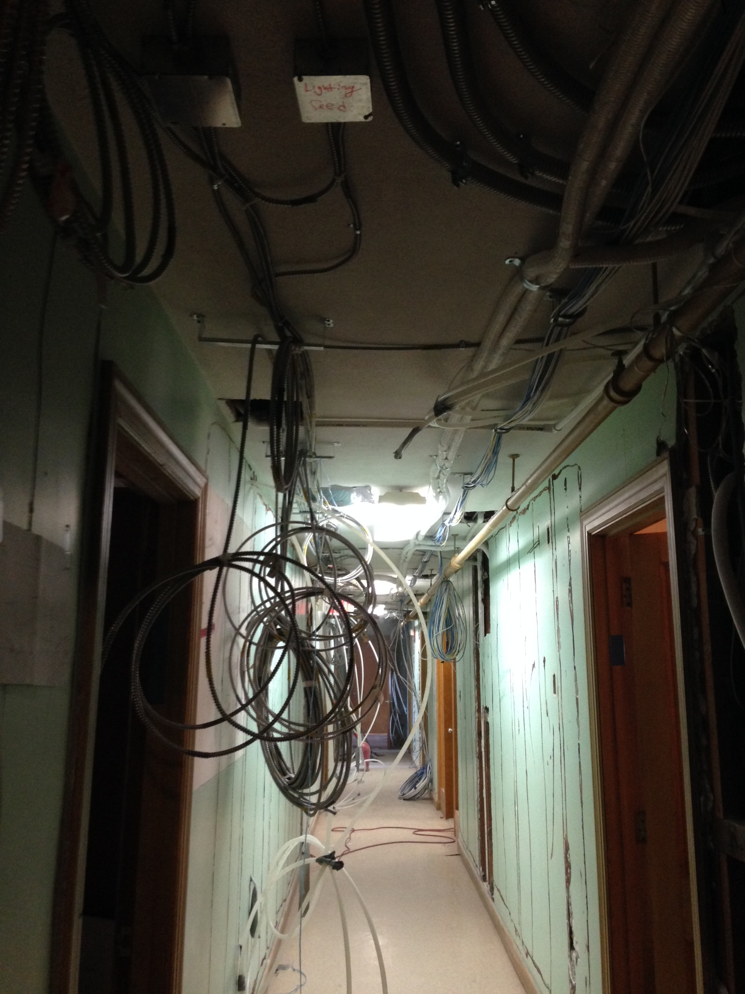
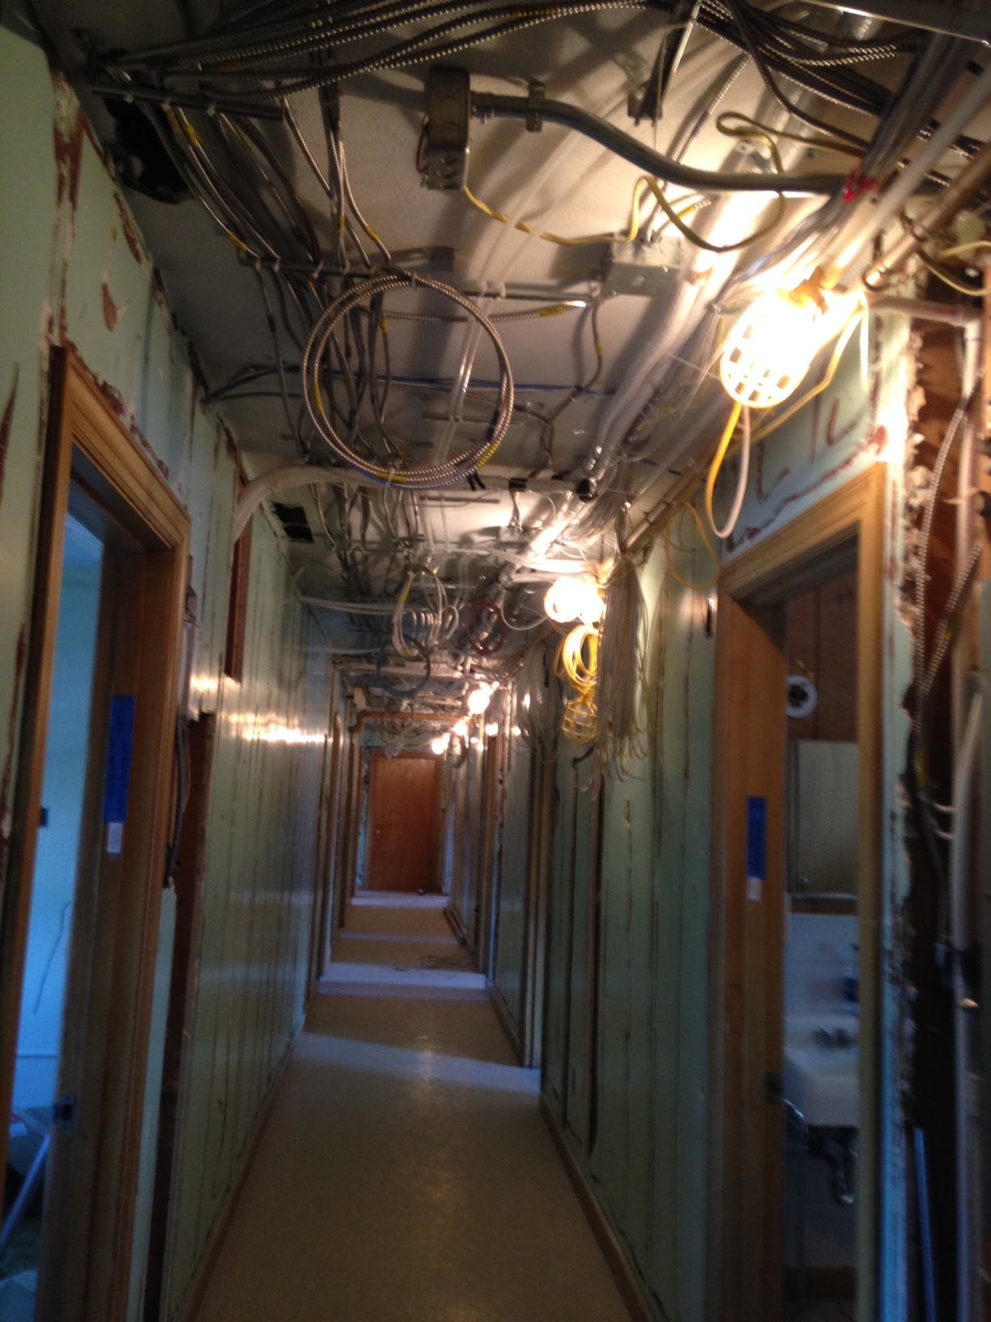
Corridor
Main Entrance
To Manor
Corridor
to 3rd floor
rooms

Slide 3
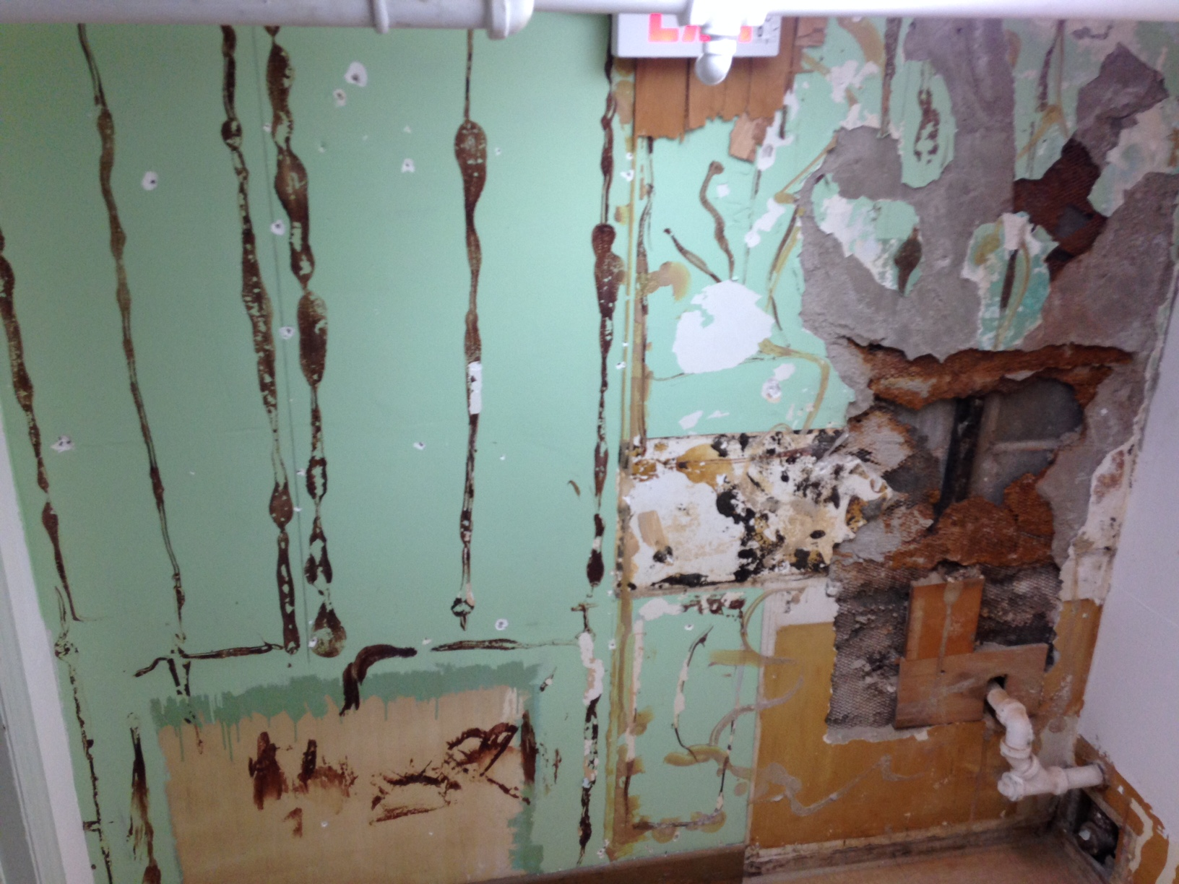
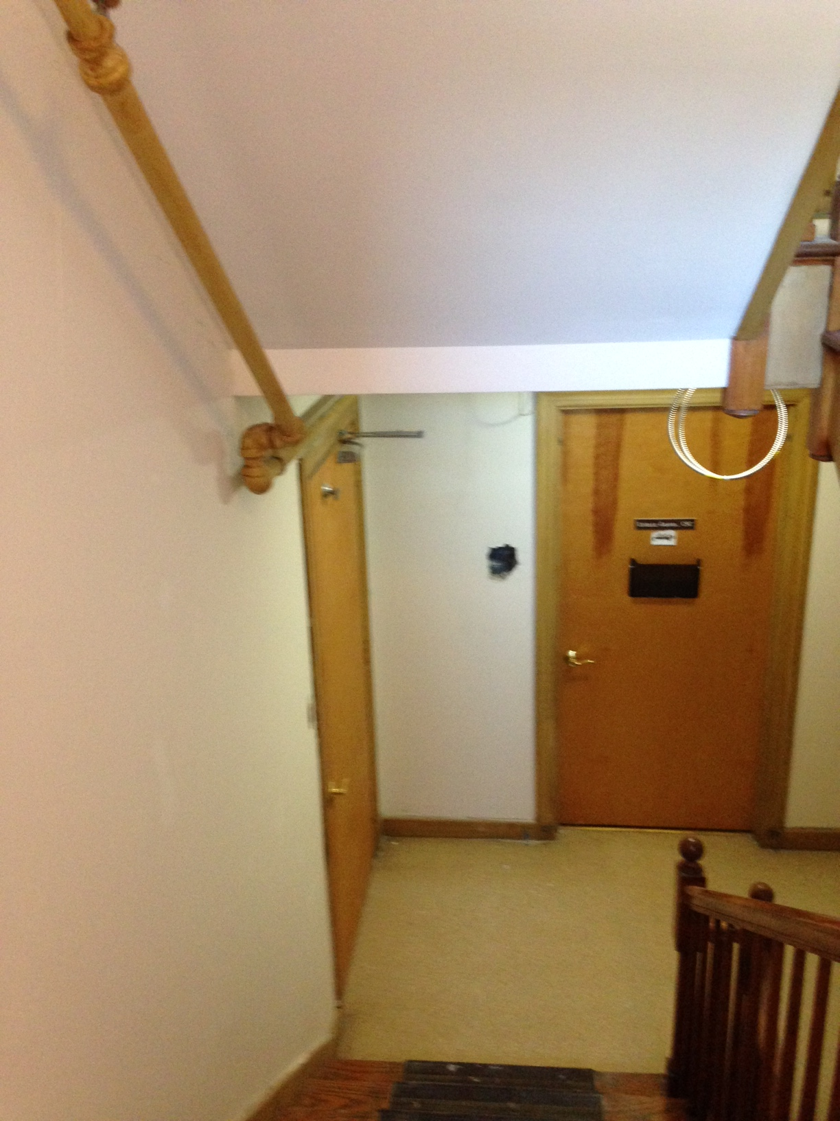
Removal of
old wood paneling
New Walls coming
down the stairs
from chapel
floor
to Sr. Lucille’s
Office

Slide 4
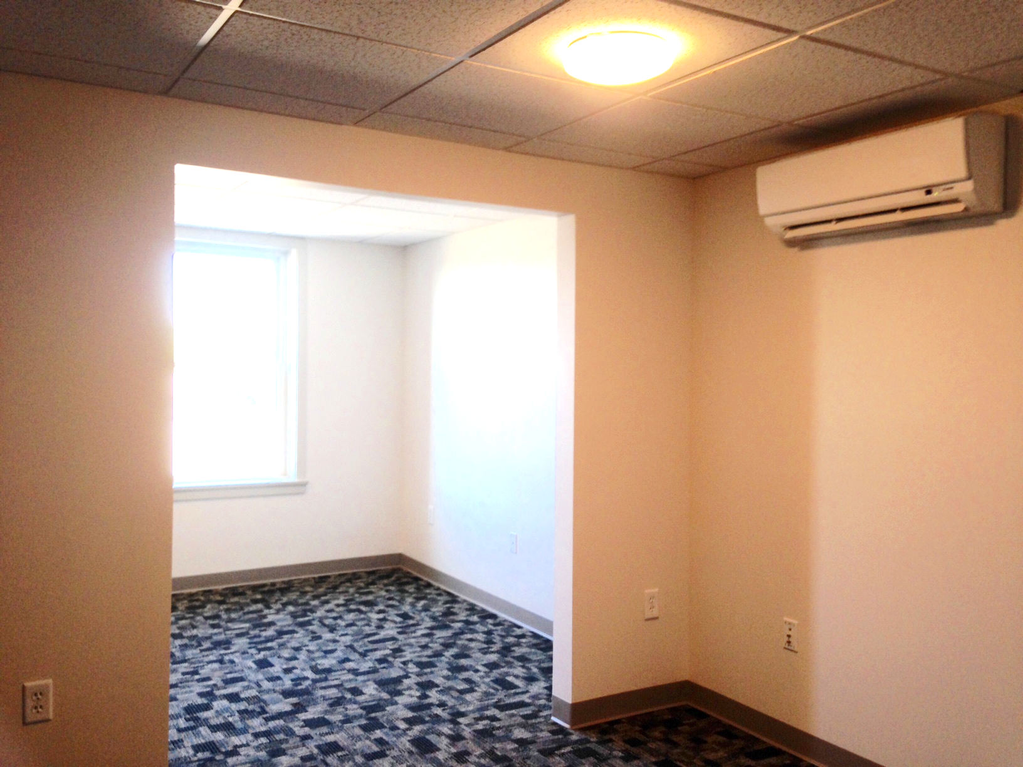
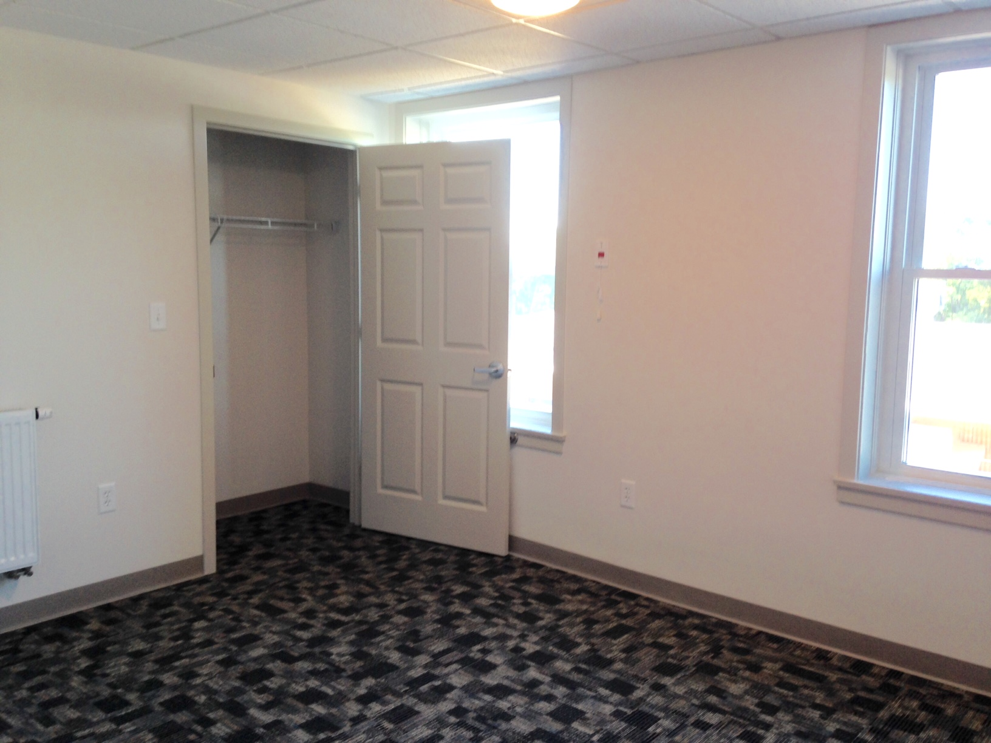
Individual
Heating and
Air conditioning
Unit in each
suite
A bedroom suite: Sitting Room
Bedroom

Slide 5
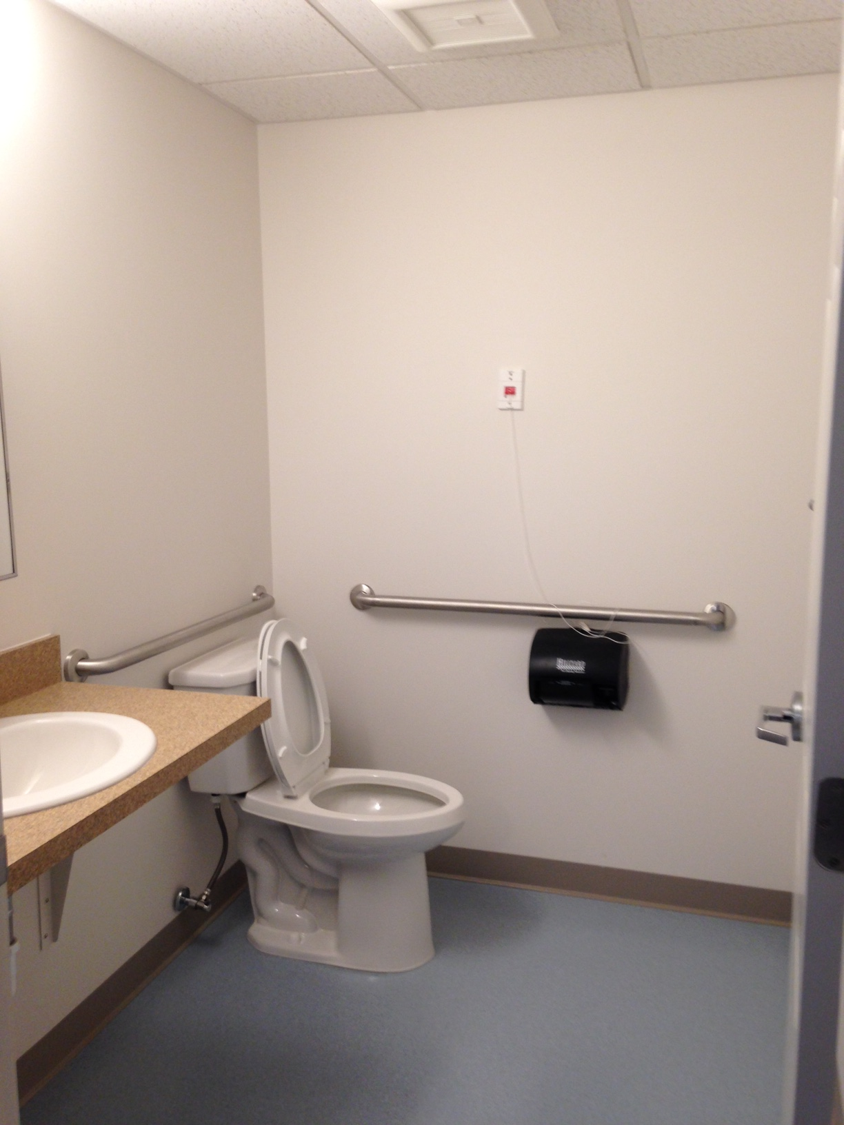
A bedroom suite (continued):
Fully Handicap accessible
half bathroom in each suite

Slide 6
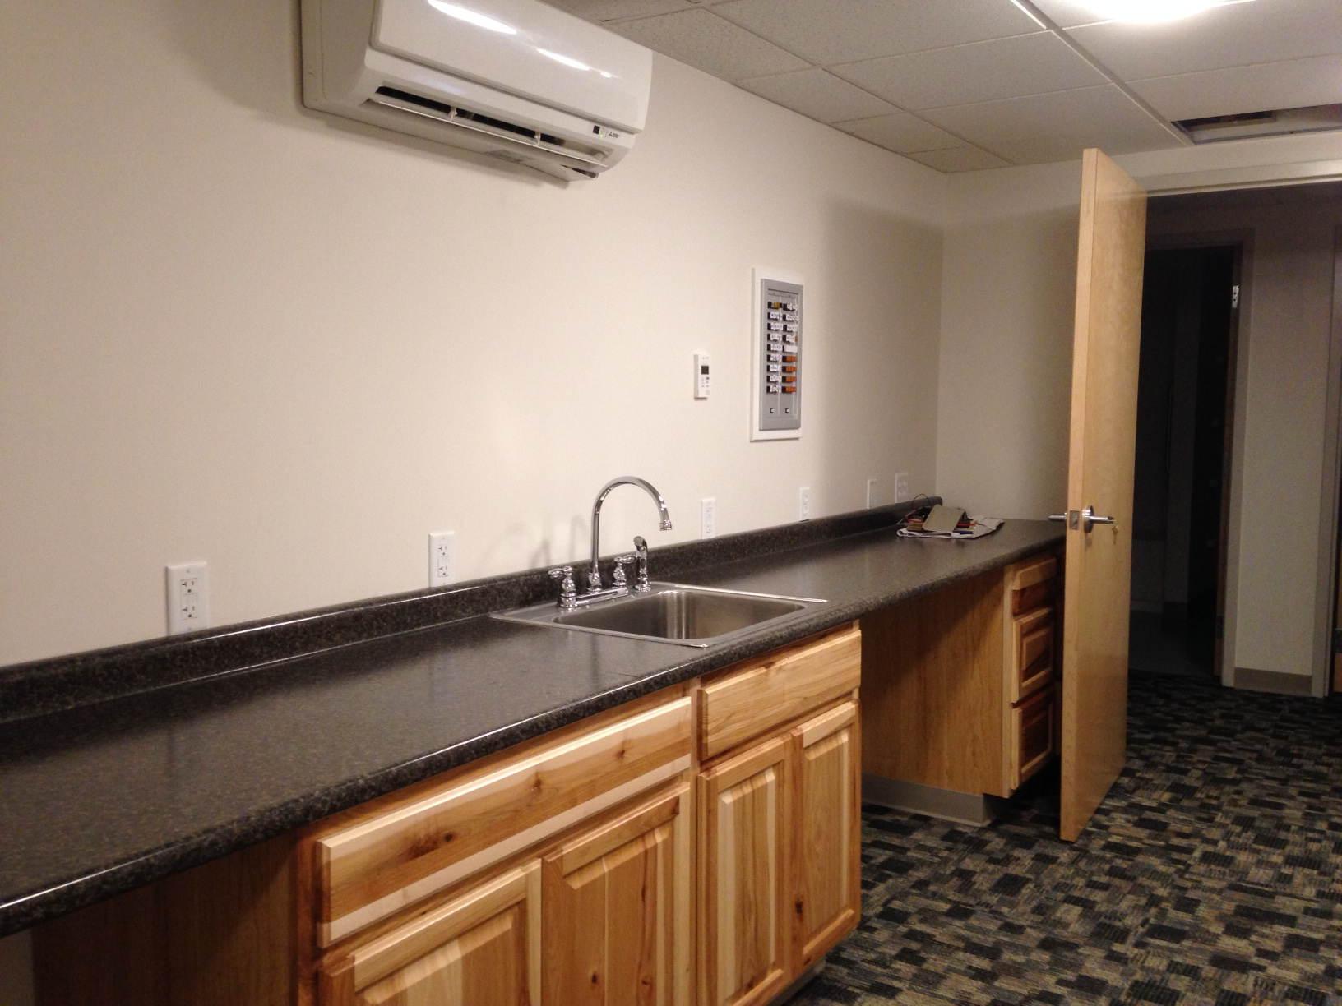
A section of the
Clinic Nurse’s Station
2nd Floor

Slide 7
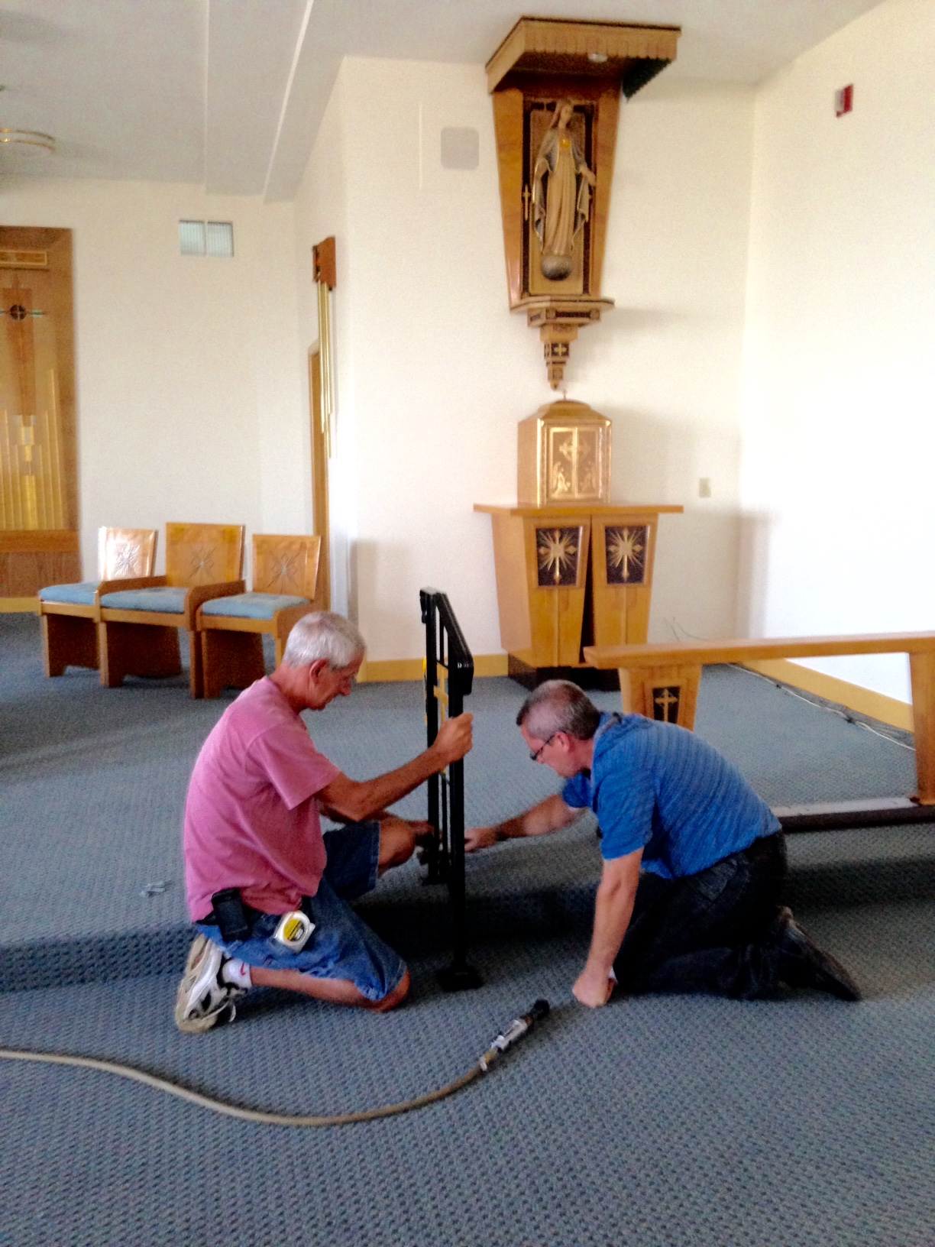
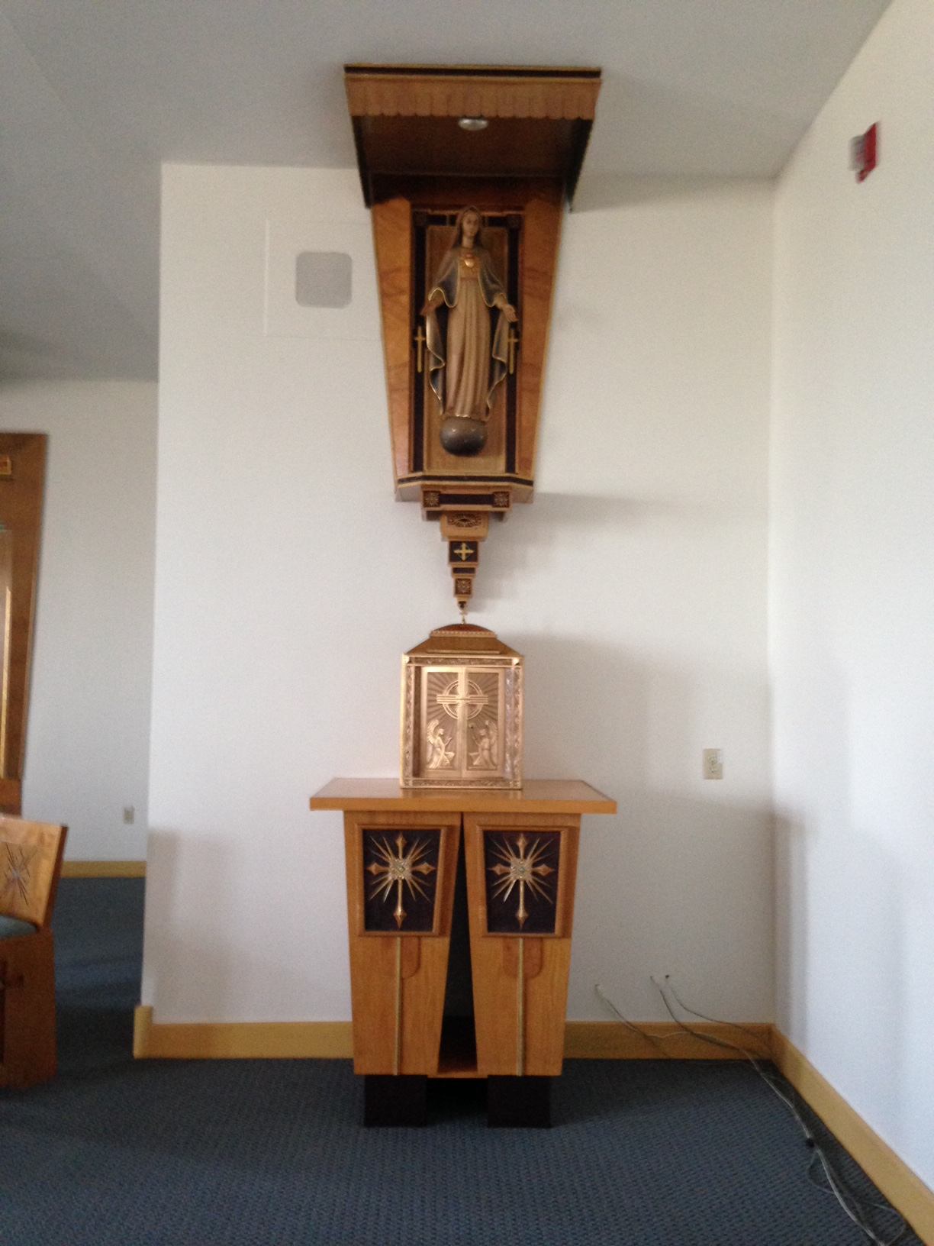
A section of the
Chapel
Mark’s
Re-adaptation
of
Tabernacle
Altar
(We have kept
Sr. Eva Ledoux’s
Designs
throughout
the chapel)

Slide 8
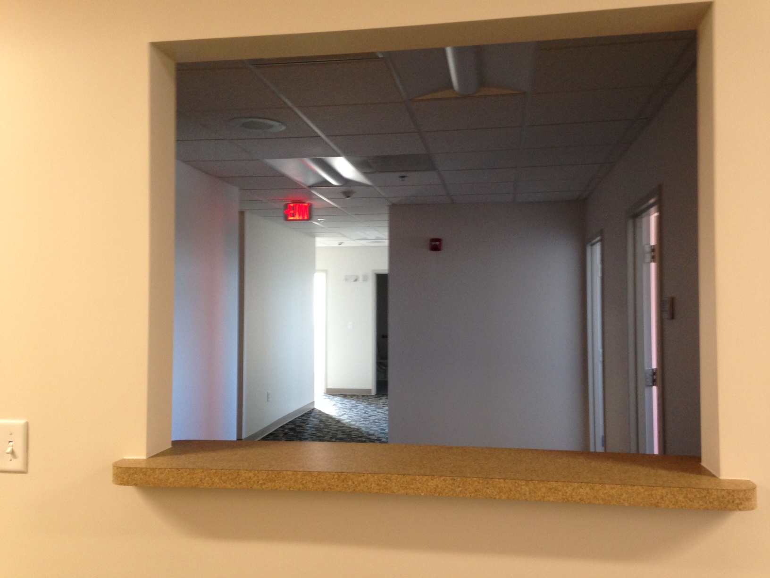
Regional
Offices
behind
the Chapel

